Slide 1
Charlotte- Mecklenburg K-12 Test Proficiency and Their Factors
Jordan Beyer, Christopher Carroll, Andrew Farmer, and Jordan Sentosa

Slide 2
Introduction
Our project revolves around the environmental and socioeconomic factors affecting test proficiency in neighborhoods around the Charlotte-Mecklenburg county region.
Our Goal: Train two models (classification and regression) on our Charlotte-Mecklenburg dataset to predict the average test proficiency of a neighborhood based on its external factors.

Slide 3
Our Two Models
Regression
Classification
Mean test proficiency percentage per neighborhood
Train model to accurately predict percentage numbers, and analyze the results to determine impactful predictors
Four categorical buckets: “At Risk”, “Low”, “Moderate”, and “High”
Train model to place neighborhoods in each category based on external factors, and compare to actual placements
XGBoost and Random Forest were the best performing models for both regression and classification.

Slide 4
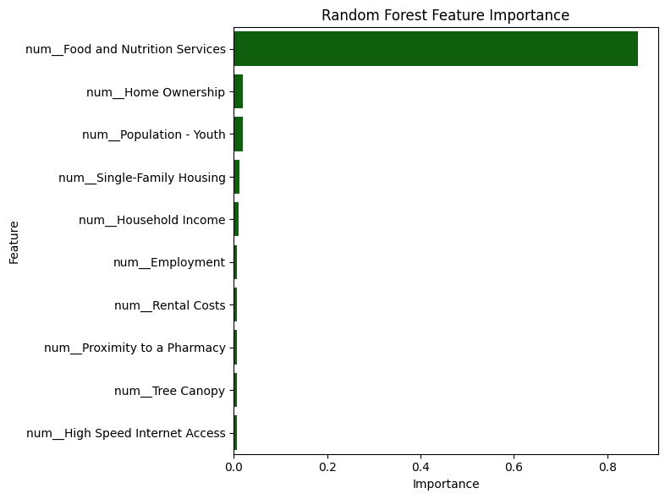
What did we find? (Regression)
Best performing model: Random Forest
Random Forest R-Squared: 0.85
Feature Importance: Food and Nutrition Services & Home Ownership
Food & Nutrition services feature importance of 86% in Random Forest – next closest feature was 2%

Slide 5
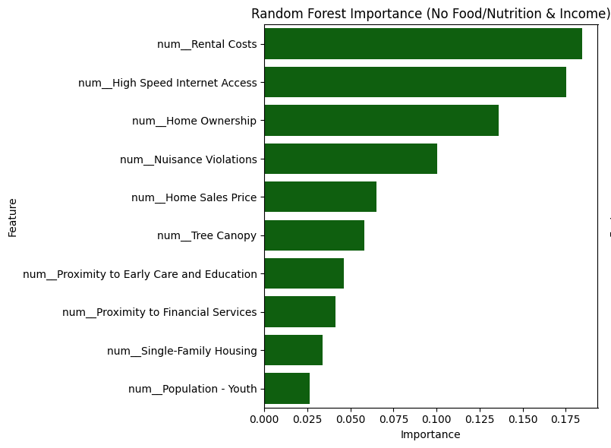
The Process (Regression)
5-Fold Cross Validation between Random Forest, XGBoost, SVR, and Linear Regression models
Unbalanced feature importance is not bad if the model accuracy is high, but leaves little interpretation for other predictors
Removing the highest predictors allows us to better see which variables influence the output without an overpowering predictor
Notes:
“As you can see the graph on the right is much more balanced and provides insight on more helpful variables such as rental costs around the area and easy access to the internet” or something like that

Slide 6
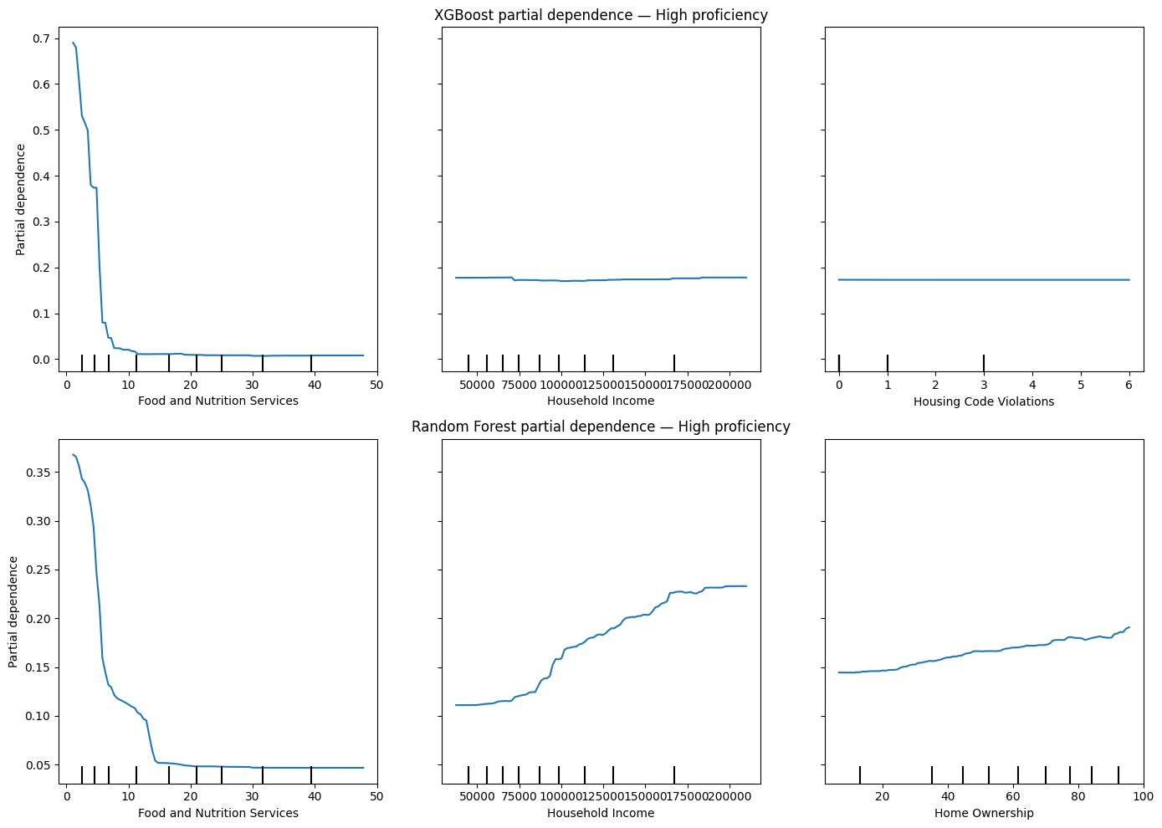
What did we find? (Classification)
Best performing model: XGBoost
XGBoost Macro Precision: 0.762
Feature Importance: Food and Nutrition Services & Household Income (again)
“At Risk” and “Low” neighborhoods often mixed together in models
Partial Dependence: Random Forest (bottom) has more distinct relationships while XGBoost (top) lacks them
Random Forest: Better explainability XGBoost: More precise

Slide 7
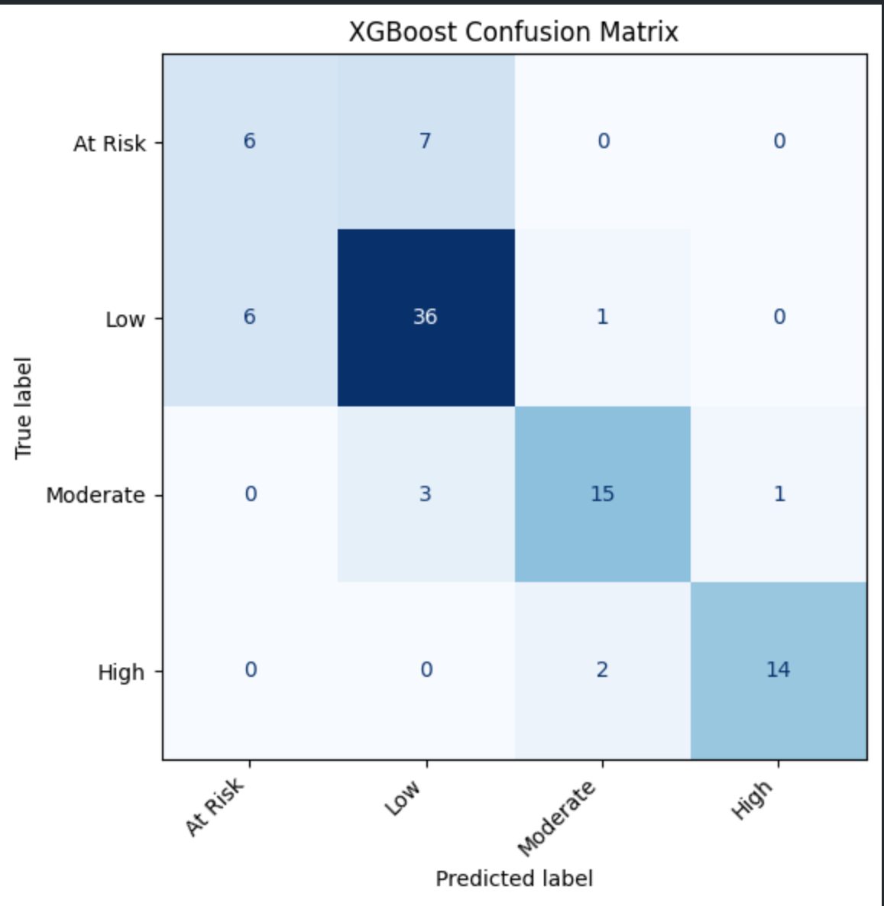
The Process (Classification)
High (75-100), Moderate (50-75), Low (25-50), At Risk (25 or lower)
5-Fold Cross Validation between LDA, QDA, SVM, Random Forest, and XGBoost models
Confusion Matrix: assessing predicted values vs actual values

Slide 8
Conclusion
What dictates lower test proficiency in neighborhoods?
More usage of food and nutrition services
Lower average household income
Lack of access to the internet
Lower house prices
The more the neighborhood is in poverty, the lower the proficiency will be.
Economic investment in lower-income neighborhoods could improve test proficiency.

Slide 9
Thank You!

